Slide 1

Linux专用
密码本
Reporter：不向C语言低头小组
崔冬辰 李尚哲 唐昊哲

Slide 2

1
选题与需求分析
2
程序设计和实现
3
我们的团队合作
4
成果展示

Slide 3


1.选题与需求分析
Why
管理账户密码
我们会遇到这样的问题
……
Who
Linux用户
1.记不住用户名
How
安装curses库后，链接编译运行
2.记不住密码
When
忘记了原来的账密，或有新账密需要添加时
3.忘记是拿来登陆啥的
4.Linux用户运行C程序不能进行屏幕操作
What
一个能够在Linux环境下可以实现屏幕操作的密码本

Slide 4
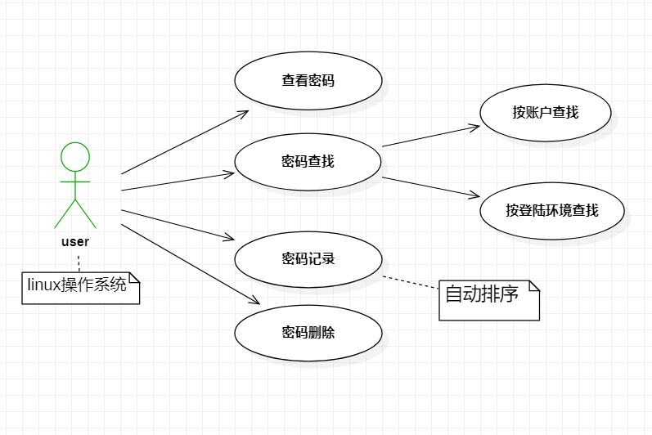
1.选题与需求分析
UML用例图

Slide 5

2.程序设计与实现
Teaching
Inspiration of Experience Learning Theory

Slide 6


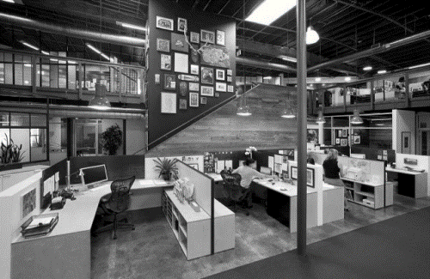
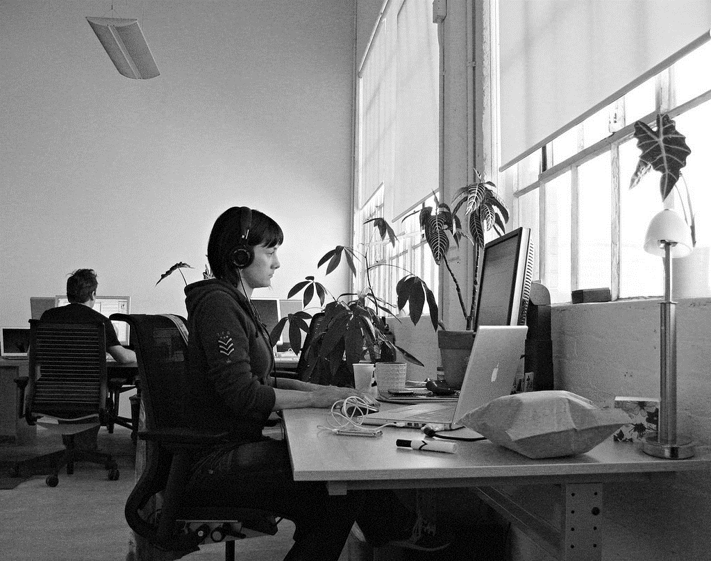
Teaching
Inspiration of Experience Learning Theory on Mathematic Activity Experience Teaching
Teaching
Teaching
Now the optimal way
Of the management of way thus wo can
Now the optimal way
Of the management of way thus wo can
Teaching
Teaching
Now the optimal way
Of the management of way thus wo can
Now the optimal way
Of the management of way thus wo can

Slide 7
Teaching
Inspiration of Experience Learning Theory on Mathematic Activity Experience Teaching
1.Now theoptimalway Of the management of way thus wo can
2.Now theoptimalway Of the management of way thus wo can
48%
65%
3.Now theoptimalway Of the management of way thus wo can
27%
12%

Slide 8

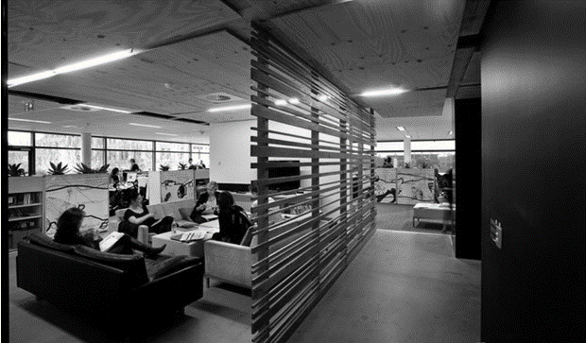
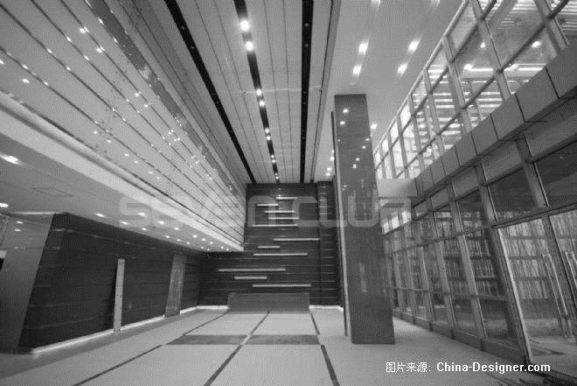
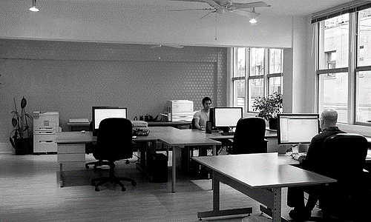
Stage plan
To enhance learning, and strive to improve their own quality

Slide 9
Stage Plan
Inspiration of Experience Learning Theory on Mathematic Activity Experience Teaching
E
D
C
B
A
0
2012
2013
2014
2015
2016
State Plan
To enhance learning, and strive to improve their own quality. According to the needs of the work, study hard safety in production of the relevant laws

Slide 10
Stage Plan
Inspiration of Experience Learning Theory on Mathematic Activity Experience Teaching
Lots of people
Wo can all do lots of things and thus the company will be bet and more.
Few people
Wo can all do lots of things and thus the company will.
63%

Slide 11

opinions
Personal recommendations are often very work to the development of our company

Slide 12
Opinion
Inspiration of Experience Learning Theory on Mathematic Activity Experience Teaching
Opinion
Opinion
Wo can all do lots of things .
Wo can all do lots of things and thus the company will be bet and more
Opinion
Wo can all do lots
Opinion
Wo can all do a lot of things thus a lot
Opinion
Wo can all do lots of things
Opinion

Slide 13
Opinion
Inspiration of Experience Learning Theory on Mathematic Activity Experience Teaching
For male Wo can all do lots of things and thus the company will be bet and more
For female Wo can all do lots of things and thus the company will be bet and more
48%
52%

Slide 14
Thank
you

